Slide 1
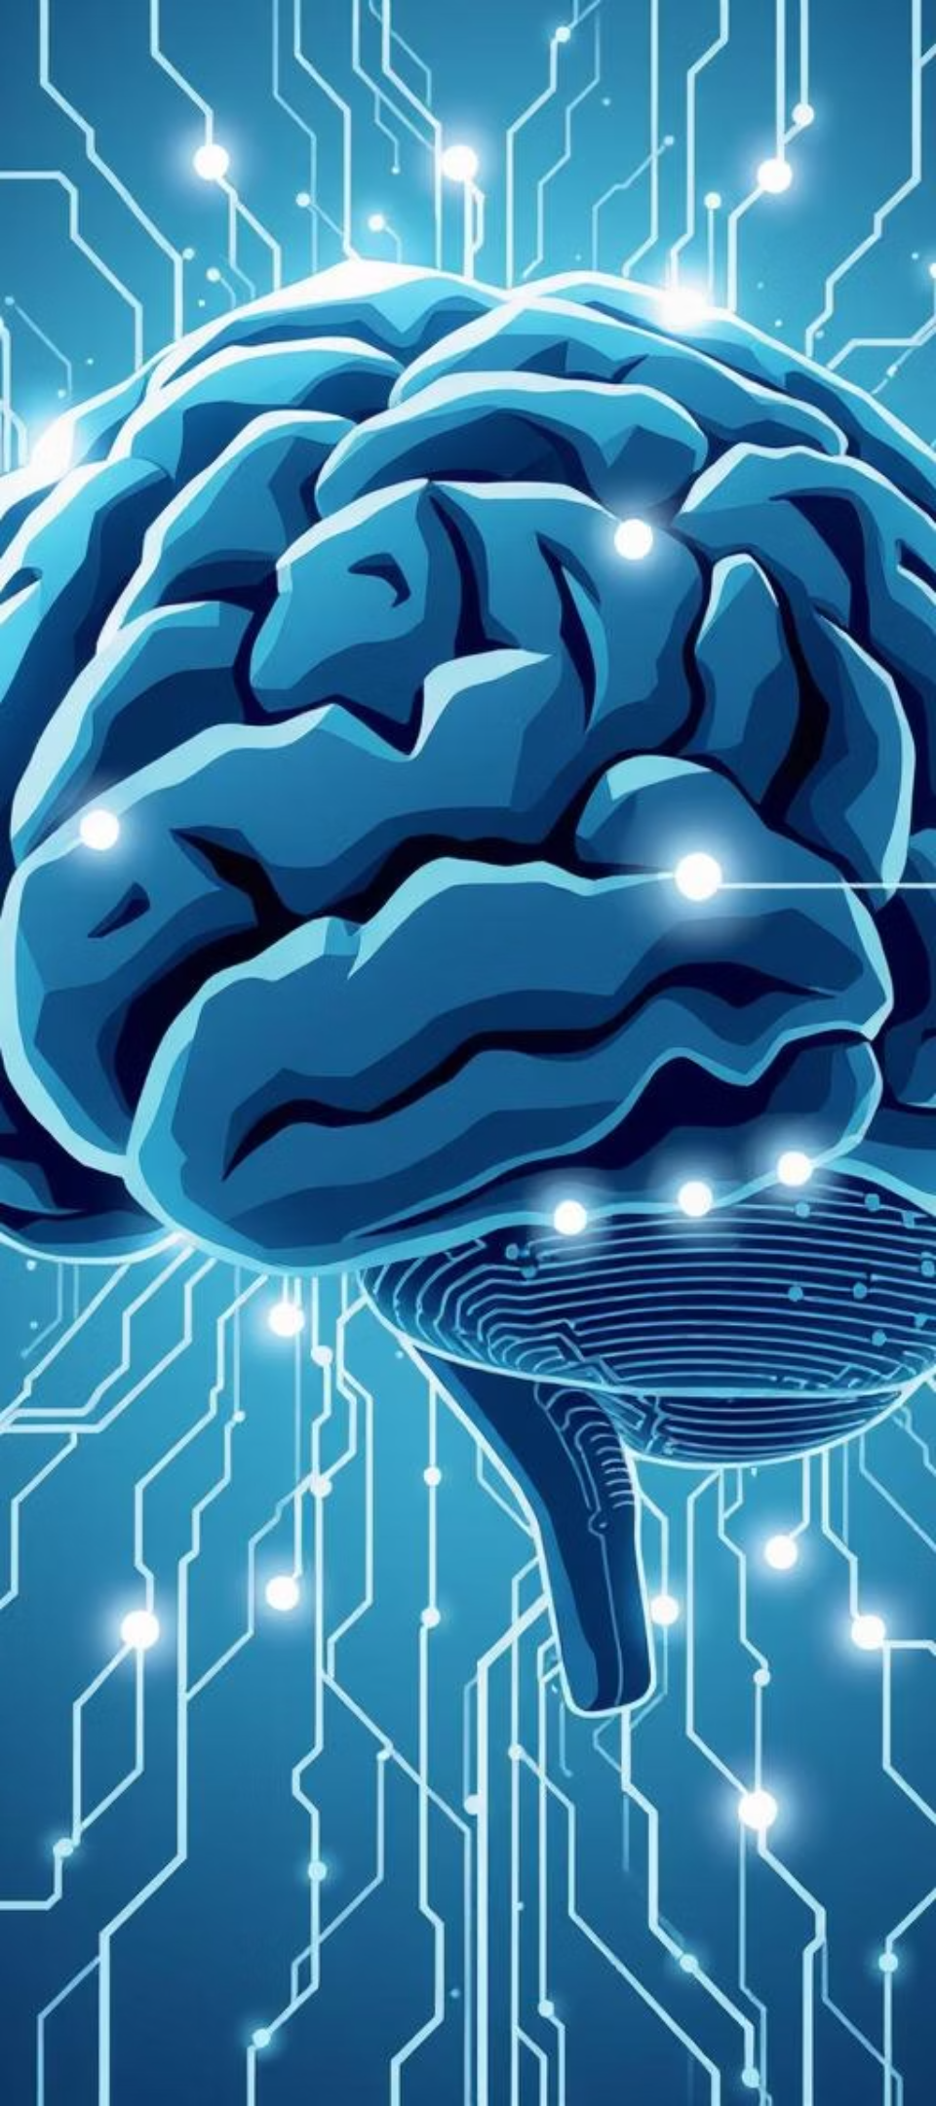
Demystifying Deep Learning: A Beginner's Journey
Embark on a comprehensive exploration into the captivating world of deep learning, from foundational concepts to real-world applications. This presentation will guide you through the essentials, perfect for beginners and intermediate learners.

Slide 2
Agenda
1
Unpacking Deep Learning
2
A Brief History
Distinguishing AI, Machine Learning, and Deep Learning.
Exploring key milestones and breakthroughs.
3
Real-World Impact
4
Tools of the Trade
Discovering diverse applications in everyday life.
Overview of popular Deep Learning frameworks.

Slide 3
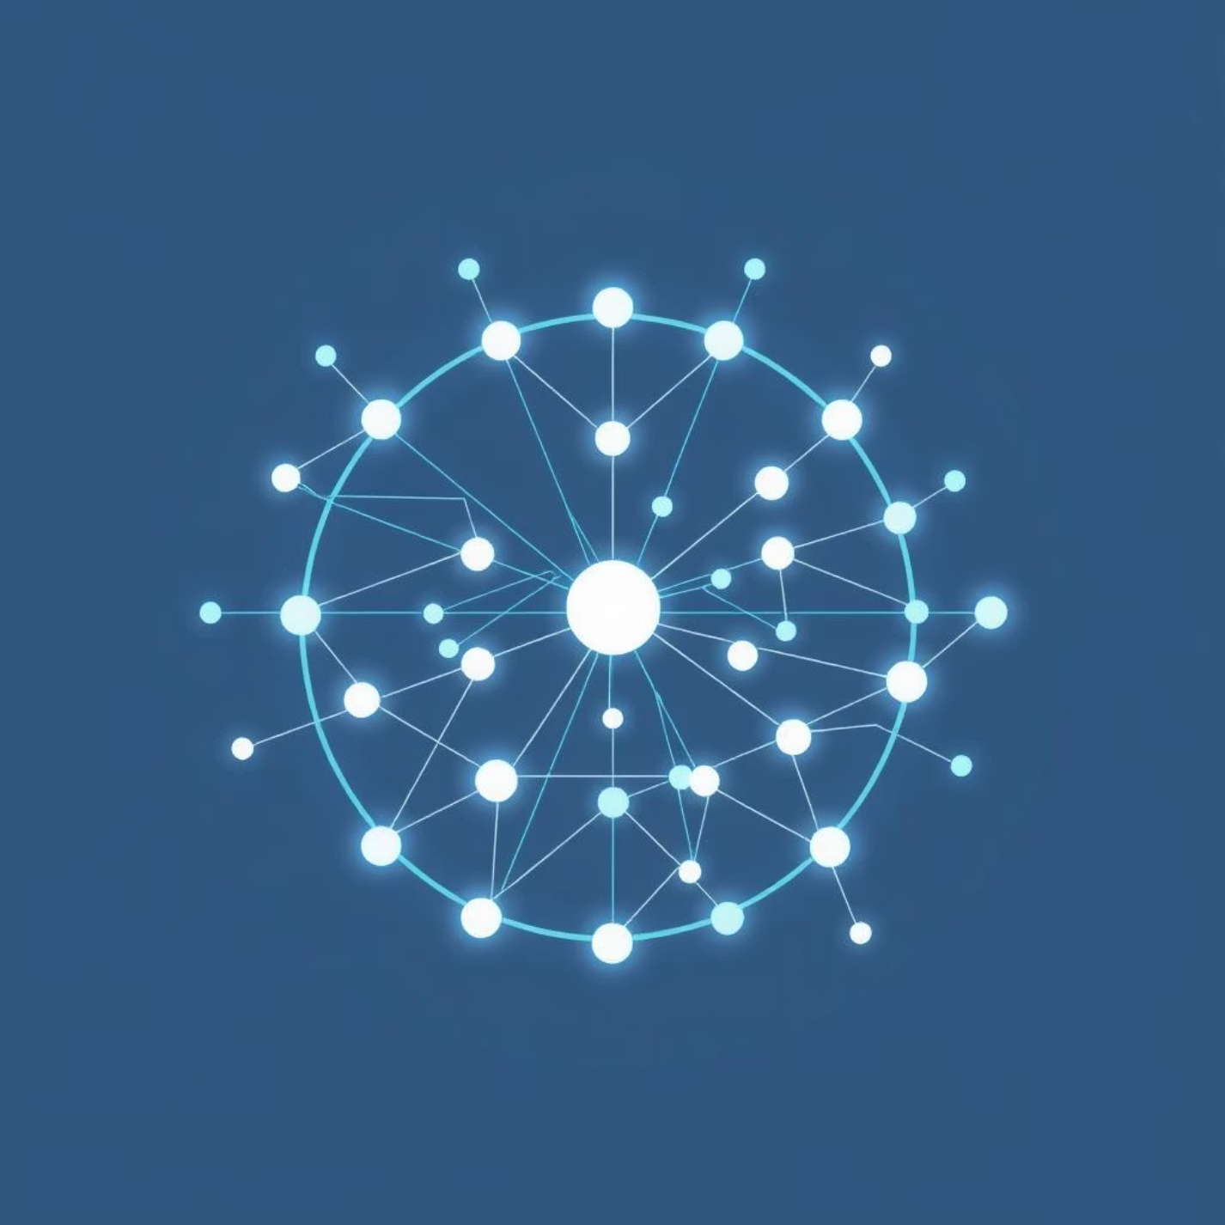
What is Deep Learning?
Deep Learning is a specialized subfield of machine learning inspired by the structure and function of the human brain. It utilizes artificial neural networks with multiple layers to learn complex patterns from vast amounts of data.
Unlike traditional machine learning, deep learning models can automatically discover and learn features directly from raw data, eliminating the need for manual feature engineering.

Slide 4



AI vs. ML vs. DL: Understanding the Landscape
Artificial Intelligence (AI)
Machine Learning (ML)
Deep Learning (DL)
The broadest concept, enabling machines to perform human-like tasks, including reasoning, problem-solving, and understanding language.
A subset of AI where systems learn from data without explicit programming. It focuses on algorithms that allow machines to improve their performance over time.
A specialized subset of ML, using multi-layered neural networks to learn intricate patterns and representations from complex datasets.

Slide 5
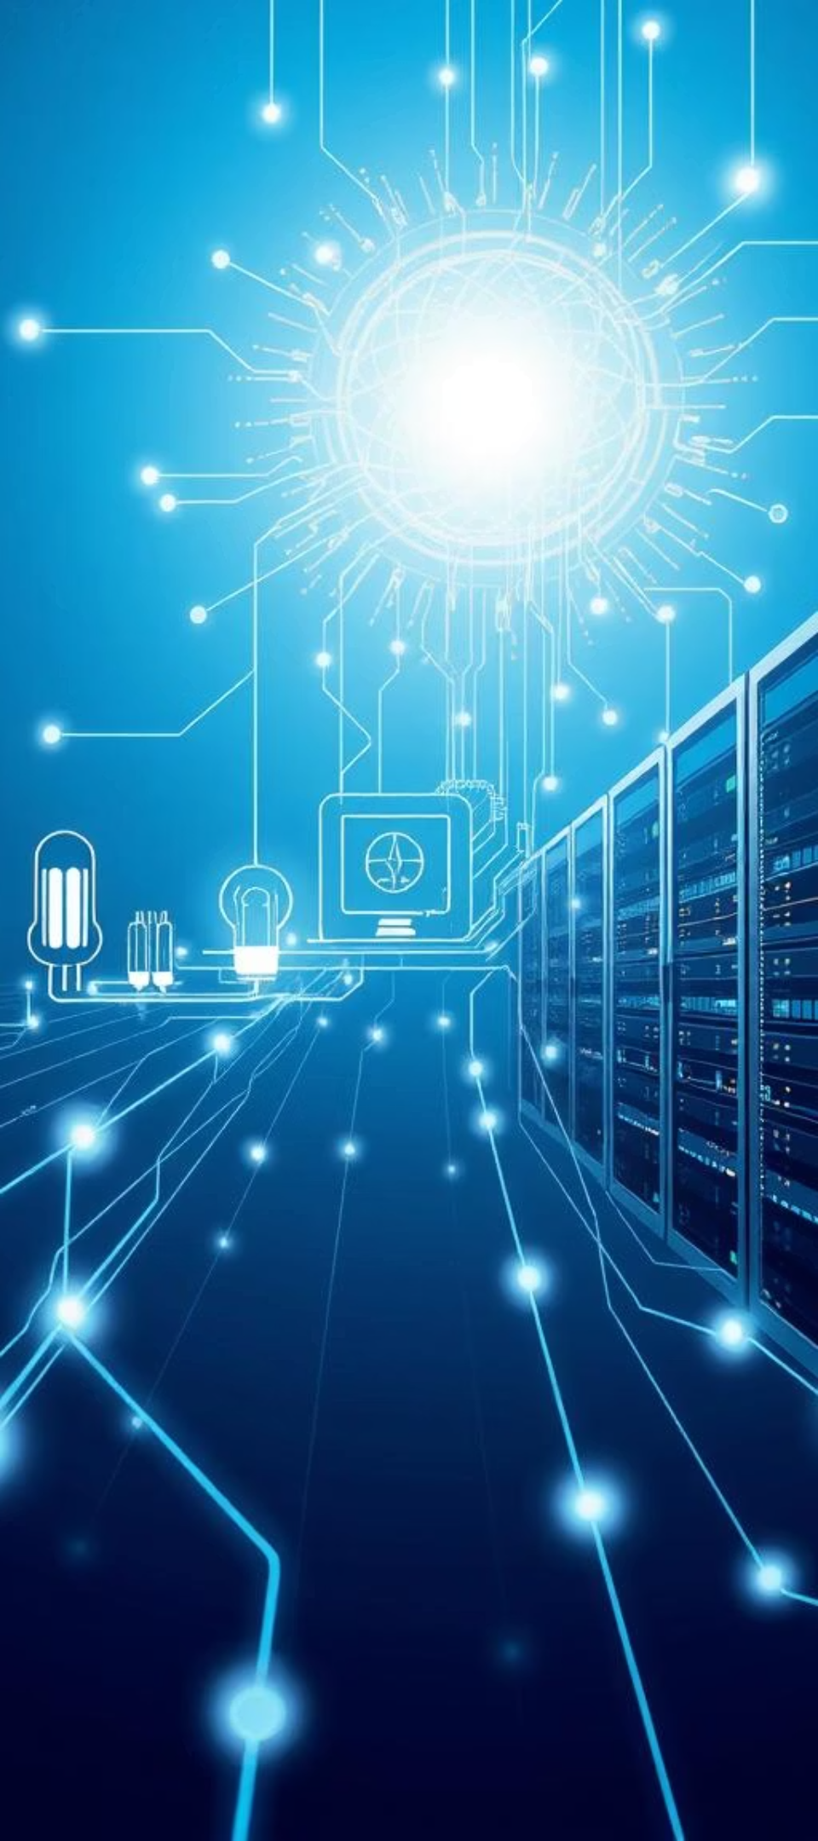
A Brief History of Deep Learning
1
1940s-1960s
Early neural network concepts, including the Perceptron, laid the groundwork for modern AI.
2
1980s-1990s
Backpropagation algorithm revitalized neural network research, enabling training of deeper networks.
3
2000s
The rise of large datasets and powerful GPUs fueled the deep learning revolution, leading to significant breakthroughs.
4
2012+
AlexNet's success in ImageNet marked a turning point, showcasing deep learning's superior performance in image recognition.

Slide 6
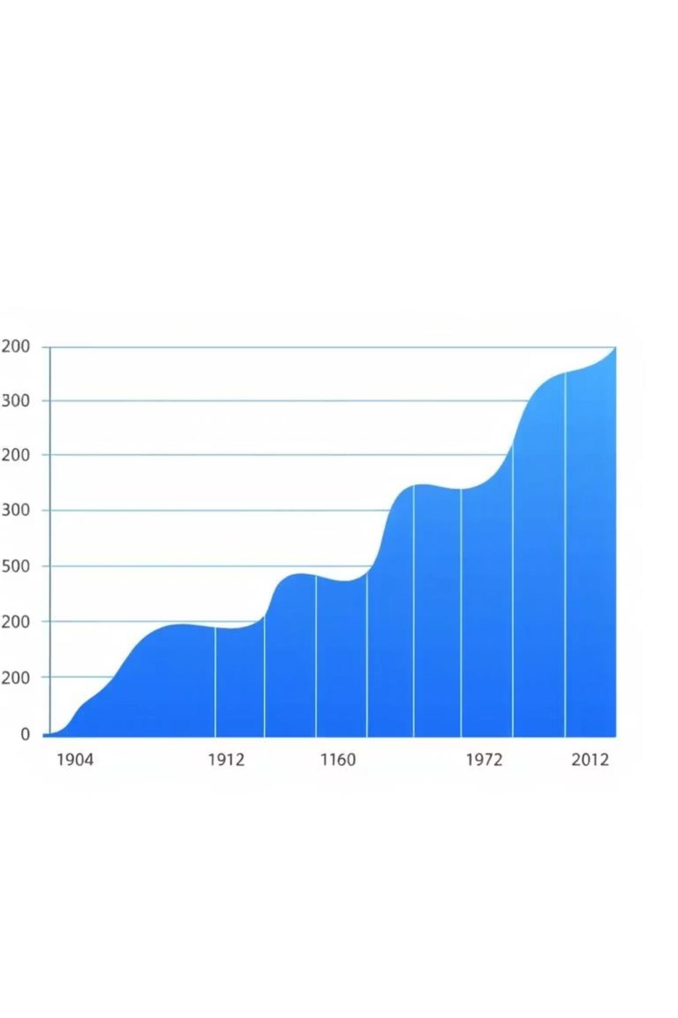
Key Breakthroughs and Milestones
ImageNet Challenge: Annual visual recognition competition that significantly propelled deep learning research forward, showcasing models like AlexNet, VGG, and ResNet.
Recurrent Neural Networks (RNNs): Crucial for sequential data processing, enabling advancements in natural language processing (NLP) and speech recognition.
Generative Adversarial Networks (GANs): Revolutionized image and data generation, creating realistic synthetic content.
Transformers: A pivotal architecture for NLP, leading to models like BERT and GPT, and driving significant progress in language understanding and generation.

Slide 7




Real-World Applications of Deep Learning
Image Recognition
Natural Language Processing (NLP)
From facial recognition in smartphones to medical image analysis, deep learning powers advanced visual understanding.
Enables chatbots, language translation, sentiment analysis, and intelligent text generation.
Autonomous Vehicles
Drug Discovery
Deep learning algorithms allow self-driving cars to perceive their surroundings, navigate, and make decisions.
Accelerating the identification of new compounds and predicting drug efficacy, revolutionizing pharmaceutical research.

Slide 8
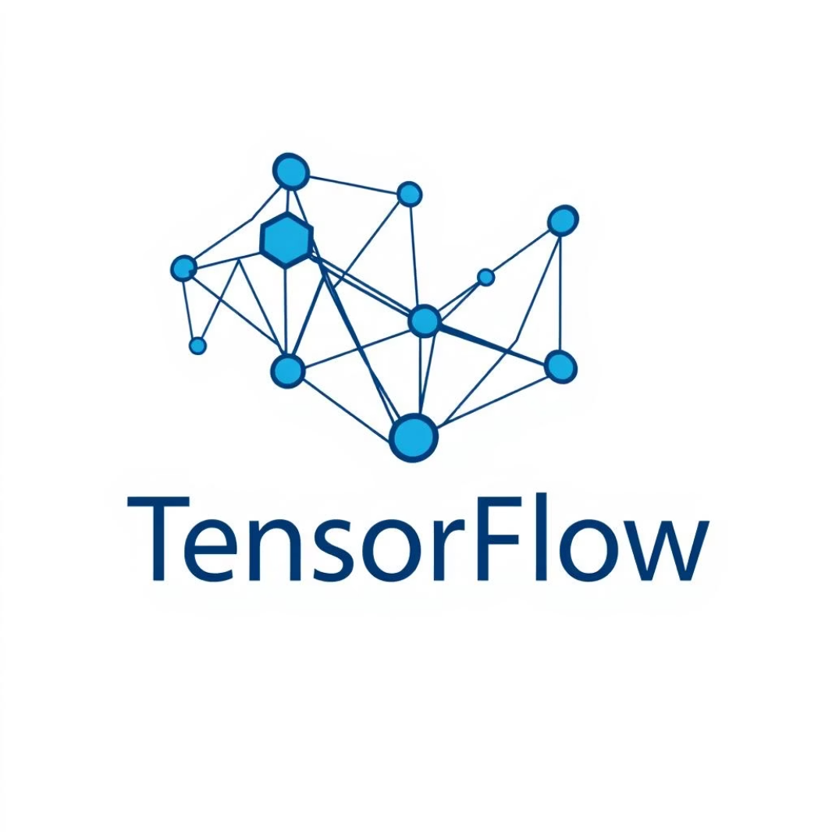


Popular Deep Learning Frameworks
TensorFlow
PyTorch
Keras
Developed by Google.
Developed by Facebook (Meta).
High-level API.
Robust for large-scale deployment.
Dynamic computation graph.
User-friendly and intuitive.
Strong community support.
Favored by researchers.
Runs on top of TensorFlow, Theano, or CNTK.

Slide 9

Activity: Discussion on Impactful DL Applications
Take a moment to consider how deep learning is currently impacting your daily life or industries you are familiar with. What applications do you find most impressive or potentially transformative?
Examples: Personalized recommendations on streaming platforms, medical diagnostics, fraud detection in finance.

Slide 10
Key Takeaways & Next Steps
DL: A Powerful Subset
Transformative Impact
Begin Your Journey
Deep Learning is a subset of Machine Learning, enabling complex pattern recognition through neural networks.
Deep Learning is driving innovation across various sectors, from healthcare to entertainment.
Explore frameworks like TensorFlow and PyTorch to start building your own deep learning models.
Thank you for joining this introduction to Deep Learning! We encourage you to delve deeper into the fascinating world of neural networks.

